Slide 1
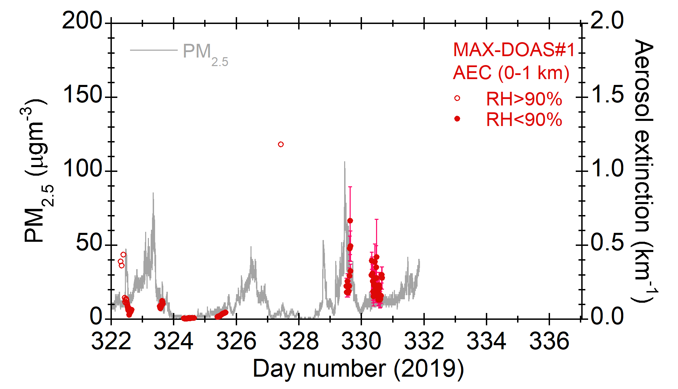
PM2.5 vs. MAX-DOAS aerosol extinction coefficient data
Agreement looks promising.
MAX-DOAS data have been categorized using near-surface RH data from MAX-DOAS H₂O data and NCEP.
MAX-DOAS values can be larger when more coarse particles were present, but not for PM_{2.5} values.

